Slide 1


Steven Morgan
5/23/2024

Slide 2

Outline
Executive Summary
Introduction
Methodology
Results
Conclusion
Appendix

Slide 3
Executive Summary
Summary of methodologies
Summary of all results

Slide 4
Introduction
Spaceflight is expensive, With the improvements of landing and reusing the first stage of a rocket we can make spaceflight cheaper and safer. Cheaper flights will increase our ability to colonize other planets, Mine asteroids and make discoveries about our universe.
The problem with reuse is that there is a rate of failure that we need to predict and reduce. This requires us to have a firm and thorough understanding of how our rockets fail. We will address this by analyzing SpaceX launches and build a model to predict success and failure of the first stage landing.

Slide 5

Section 1

Slide 6
Methodology
Executive Summary
Data collection methodology:
Describe how data was collected
Perform data wrangling
Describe how data was processed
Perform exploratory data analysis (EDA) using visualization and SQL
Perform interactive visual analytics using Folium and Plotly Dash
Perform predictive analysis using classification models
How to build, tune, evaluate classification models

Slide 7
Data Collection
Describe how data sets were collected.
You need to present your data collection process use key phrases and flowcharts

Slide 8
Data Collection – SpaceX API
Present your data collection with SpaceX REST calls using key phrases and flowcharts
Add the GitHub URL of the completed SpaceX API calls notebook (must include completed code cell and outcome cell), as an external reference and peer-review purpose
Place your flowchart of SpaceX API calls here

Slide 9
Data Collection - Scraping
Present your web scraping process using key phrases and flowcharts
Add the GitHub URL of the completed web scraping notebook, as an external reference and peer-review purpose
Place your flowchart of web scraping here

Slide 10
Data Wrangling
Describe how data were processed
You need to present your data wrangling process using key phrases and flowcharts
Add the GitHub URL of your completed data wrangling related notebooks, as an external reference and peer-review purpose

Slide 11
EDA with Data Visualization
Summarize what charts were plotted and why you used those charts
Add the GitHub URL of your completed EDA with data visualization notebook, as an external reference and peer-review purpose

Slide 12
EDA with SQL
Using bullet point format, summarize the SQL queries you performed
Add the GitHub URL of your completed EDA with SQL notebook, as an external reference and peer-review purpose

Slide 13
Build an Interactive Map with Folium
Summarize what map objects such as markers, circles, lines, etc. you created and added to a folium map
Explain why you added those objects
Add the GitHub URL of your completed interactive map with Folium map, as an external reference and peer-review purpose

Slide 14
Build a Dashboard with Plotly Dash
Summarize what plots/graphs and interactions you have added to a dashboard
Explain why you added those plots and interactions
Add the GitHub URL of your completed Plotly Dash lab, as an external reference and peer-review purpose

Slide 15
Predictive Analysis (Classification)
Summarize how you built, evaluated, improved, and found the best performing classification model
You need present your model development process using key phrases and flowchart
Add the GitHub URL of your completed predictive analysis lab, as an external reference and peer-review purpose

Slide 16
Results
Exploratory data analysis results
Interactive analytics demo in screenshots
Predictive analysis results

Slide 17

Section 2

Slide 18
Flight Number vs. Launch Site
Show a scatter plot of Flight Number vs. Launch Site
Show the screenshot of the scatter plot with explanations

Slide 19
Payload vs. Launch Site
Show a scatter plot of Payload vs. Launch Site
Show the screenshot of the scatter plot with explanations

Slide 20
Success Rate vs. Orbit Type
Show a bar chart for the success rate of each orbit type
Show the screenshot of the scatter plot with explanations

Slide 21
Flight Number vs. Orbit Type
Show a scatter point of Flight number vs. Orbit type
Show the screenshot of the scatter plot with explanations

Slide 22
Payload vs. Orbit Type
Show a scatter point of payload vs. orbit type
Show the screenshot of the scatter plot with explanations

Slide 23
Launch Success Yearly Trend
Show a line chart of yearly average success rate
Show the screenshot of the scatter plot with explanations

Slide 24
All Launch Site Names
Find the names of the unique launch sites
Present your query result with a short explanation here

Slide 25
Launch Site Names Begin with 'CCA'
Find 5 records where launch sites begin with `CCA`
Present your query result with a short explanation here

Slide 26
Total Payload Mass
Calculate the total payload carried by boosters from NASA
Present your query result with a short explanation here

Slide 27
Average Payload Mass by F9 v1.1
Calculate the average payload mass carried by booster version F9 v1.1
Present your query result with a short explanation here

Slide 28
First Successful Ground Landing Date
Find the dates of the first successful landing outcome on ground pad
Present your query result with a short explanation here

Slide 29
Successful Drone Ship Landing with Payload between 4000 and 6000
List the names of boosters which have successfully landed on drone ship and had payload mass greater than 4000 but less than 6000
Present your query result with a short explanation here

Slide 30
Total Number of Successful and Failure Mission Outcomes
Calculate the total number of successful and failure mission outcomes
Present your query result with a short explanation here

Slide 31
Boosters Carried Maximum Payload
List the names of the booster which have carried the maximum payload mass
Present your query result with a short explanation here

Slide 32
2015 Launch Records
List the failed landing_outcomes in drone ship, their booster versions, and launch site names for in year 2015
Present your query result with a short explanation here

Slide 33
Rank Landing Outcomes Between 2010-06-04 and 2017-03-20
Rank the count of landing outcomes (such as Failure (drone ship) or Success (ground pad)) between the date 2010-06-04 and 2017-03-20, in descending order
Present your query result with a short explanation here

Slide 34

Section 3

Slide 35
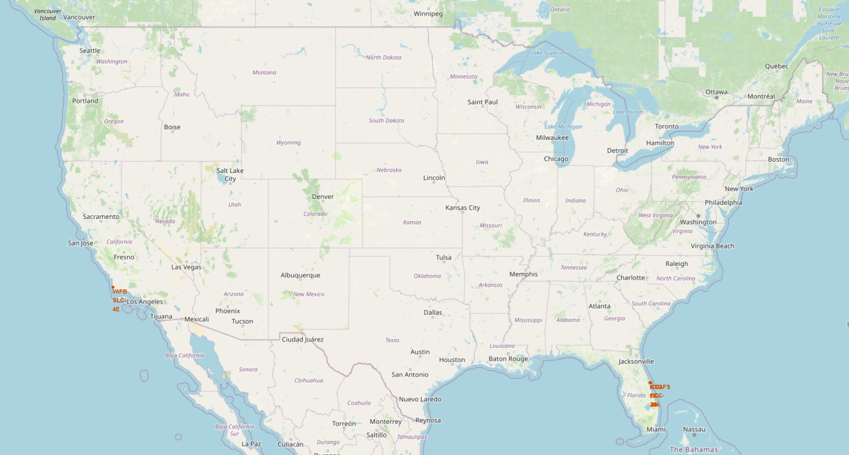
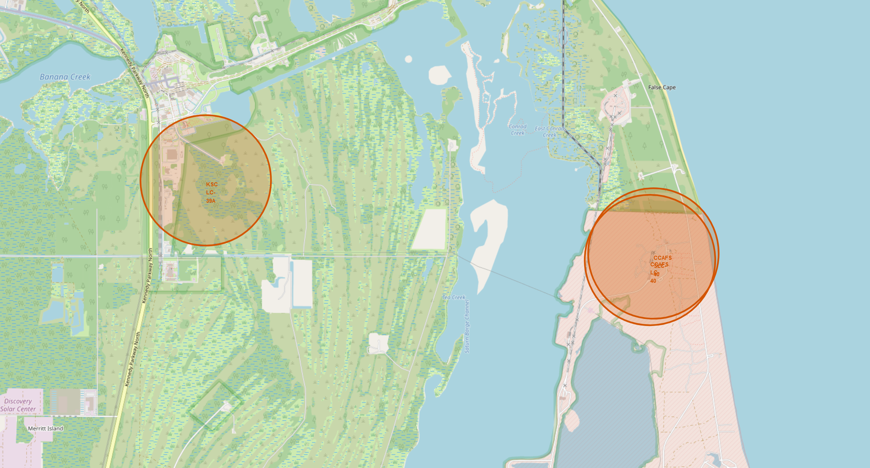
Locations of
SpaceX
Launch Sites
¾ of the launch sites are located within a few miles of each other on the east coast. This allows for analysis to be simplified as they have similar Weather and Environmental factors.
All the east coast launch sites are non-military sites. This might affect launch requirements.
The launch site at Vandenburg is the only site that allows for polar orbits. Polar orbits are different as they do not go with spin of the atmosphere and could experience different forces on the rocket.

Slide 36
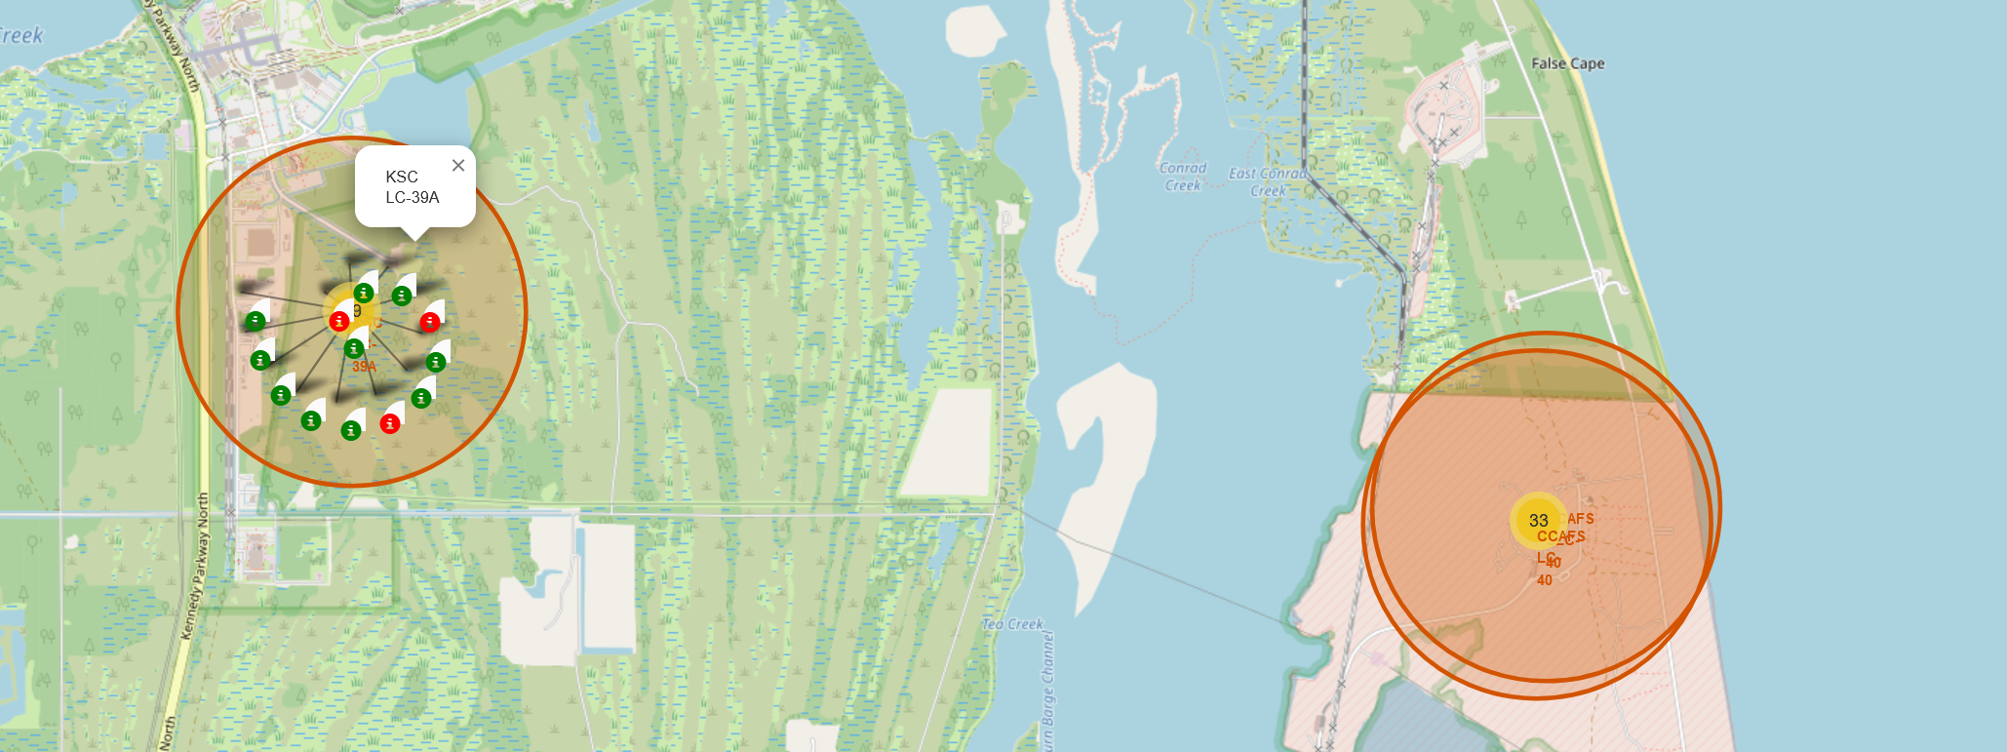
Launch Clusters with Success indicators
The Map is updated to show the location of launches and the success of the launch. Green indicating success and Red indicating a failure of some kind.
To have a clean map the launched are grouped into yellow circles showing the number of launches. Once clicked it reveals all the launches in a spiral pattern.
This allows for easier analysis at a glance to see where physical the most failures occurred.

Slide 37
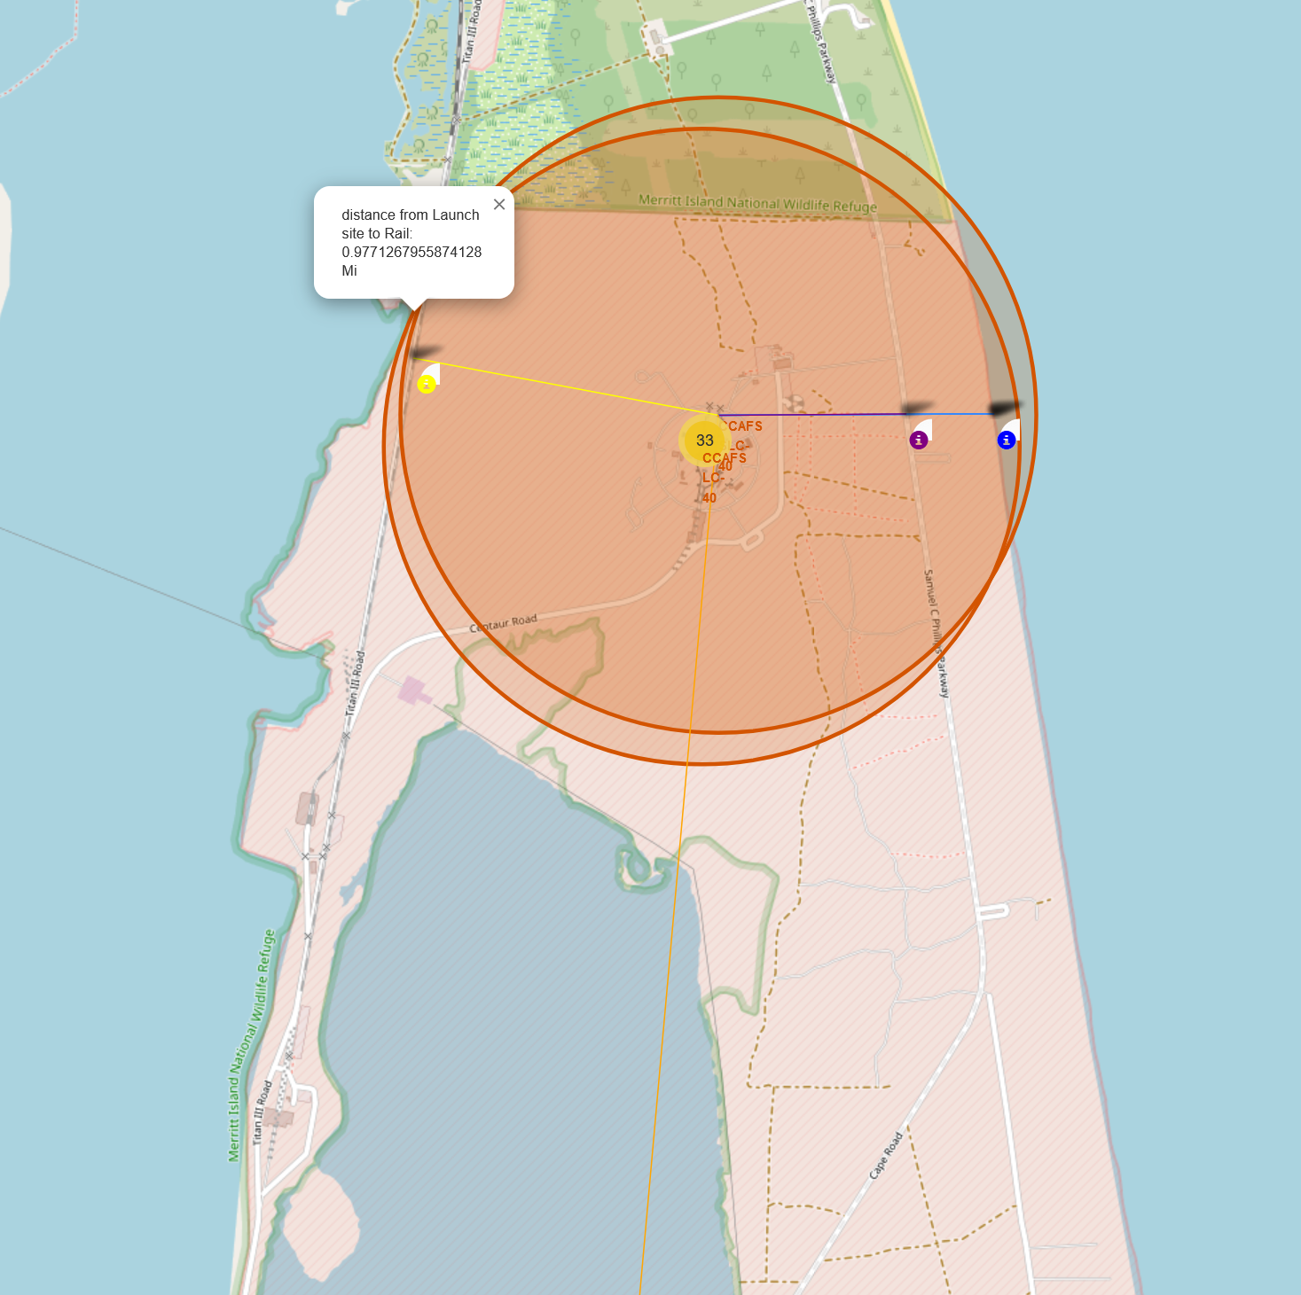
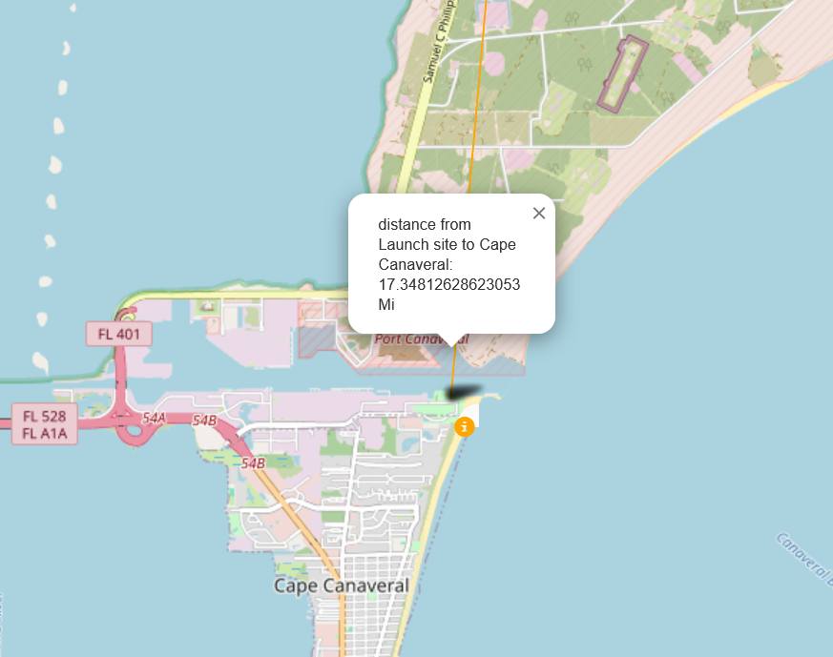
Distances to near by infrastructure
The location of near by buildings and infrastructure might play a role in the success of rockets. Roads or track could be damaged by rockets launches if too close. Passing traffic could endanger the rockets, that is why they are over half a mile to the closest highway or track
The nearest city is cape Canaveral which is over 17 miles away. The safety of the people is much greater as rockets when launching produce large pressure waves and sound, And much more so when they fail!

Slide 38

Section 4

Slide 39
<Dashboard Screenshot 1>
Replace <Dashboard screenshot 1> title with an appropriate title
Show the screenshot of launch success count for all sites, in a piechart
Explain the important elements and findings on the screenshot

Slide 40
<Dashboard Screenshot 2>
Replace <Dashboard screenshot 2> title with an appropriate title
Show the screenshot of the piechart for the launch site with highest launch success ratio
Explain the important elements and findings on the screenshot

Slide 41
<Dashboard Screenshot 3>
Replace <Dashboard screenshot 3> title with an appropriate title
Show screenshots of Payload vs. Launch Outcome scatter plot for all sites, with different payload selected in the range slider
Explain the important elements and findings on the screenshot, such as which payload range or booster version have the largest success rate, etc.

Slide 42

Section 5

Slide 43
Classification Accuracy
Visualize the built model accuracy for all built classification models, in a bar chart
Find which model has the highest classification accuracy

Slide 44
Confusion Matrix
Show the confusion matrix of the best performing model with an explanation

Slide 45
Conclusions
Point 1
Point 2
Point 3
Point 4
…

Slide 46
Appendix
Include any relevant assets like Python code snippets, SQL queries, charts, Notebook outputs, or data sets that you may have created during this project

Slide 47


